Slide 1
CHGM-141
General and Analytical Chemistry I
Lecture 17 (Ch. 6) with Dr. Bailey
SOLUTIONS
Properties of Compounds in Aqueous Solutions
Solution Concentration, Molarity
Dilution
Solution Stoichiometry

Slide 2
Solutions
when table salt is mixed with water, it seems to disappear, or become a liquid – the mixture is homogeneous
  the salt is still there, as you can tell from the taste, or simply boiling away the water
A solution is a homogeneous mixture in which the two or more components mix freely
The solvent is taken as the component present in the largest amount
A solute is any substance dissolved in the solvent

Slide 3
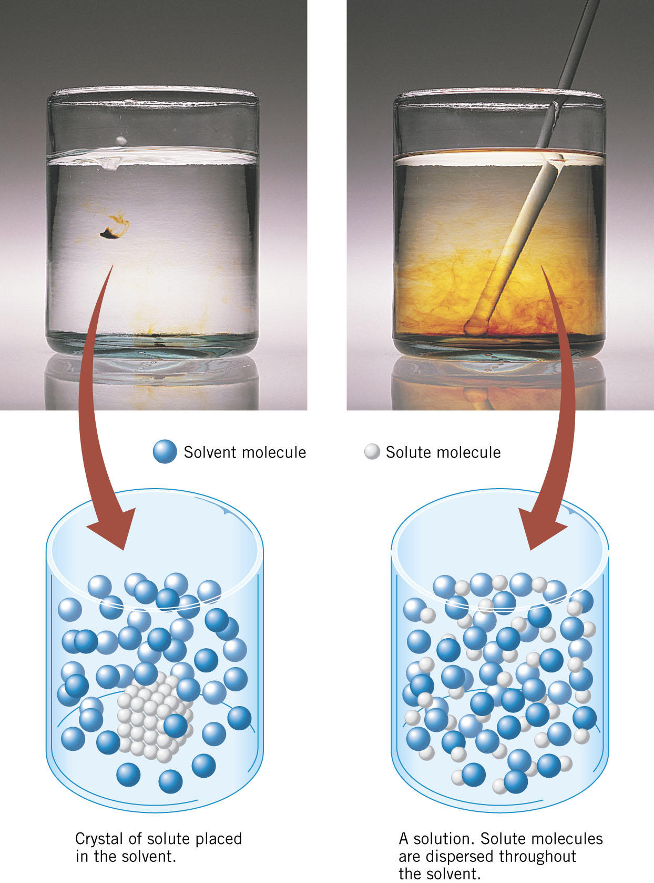
Examples of Solutions
Formation of solution of iodine molecules in ethyl alcohol.
Ethyl alcohol is the solvent and iodine the solute.

Slide 4
Examples of Solutions
Saline (salt water) is a solution. The solvent is water, the solute is salt.
Wet salt is also a solution. The solvent is salt, the solute is water.
The solvent is taken as the component present in the largest amount
A solute is any substance dissolved in the solvent

Slide 5
Examples of Solutions
160 proof Vodka
What is the solvent?
Alcohol – It is 80% alcohol.
What is the solute?
Water – It is 20% water.

Slide 6
Aqueous Solutions
Aqueous solutions are specifically solutions where water is the solvent.
Aqueous solutions are a very common medium for performing chemical reactions.
Advantages of Aqueous Solutions…

Slide 7
Advantages of Aqueous Solutions
Mixing – you can stir the solution.
Ability to dissipate heat (or cold) – the mass of the solvent allows it to absorb significant amounts of heat (or cold).
“Universal solvent” – water dissolves many different materials, especially ionic materials.

Slide 8
Describing Solutions
since solutions are mixtures, the composition can vary from one sample to another
  pure substances have constant composition
  salt water samples from different seas or lakes have different amounts of salt
so to describe solutions accurately, we must describe how much of each component is present
Solution Concentration…

Slide 9
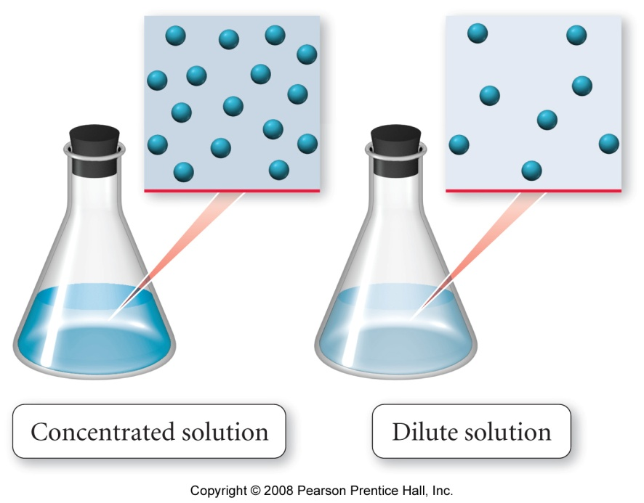
Solution Concentration
qualitatively, solutions are often described as dilute or concentrated
dilute solutions have a small amount of solute compared to solvent
concentrated solutions have a large amount of solute compared to solvent
quantitatively, the relative amount of solute in the solution is called the concentration

Slide 10
Concentration
Because a solution is a mixture – there are different ratios of solvent/solute quantities possible.
For example,
I could put 1 teaspoon of salt in a cup of water OR
I could put 2 teaspoons of salt in a cup of water.
Both are saline solutions, but they have different amounts of salt.
Solutions are characterized by their concentration

Slide 11
Common Concentration Units
% by mass - g solute/100 g solution
Molarity (M) - moles solute/L solution
Molality (m) - moles solute/kg solvent
% by volume - mL solute/100 mL solution
mass-volume % - g solvent/100 mL solution
Mole Fraction – moles solute/total moles of all species
Mole % - moles solute/100 moles of all species

Slide 12
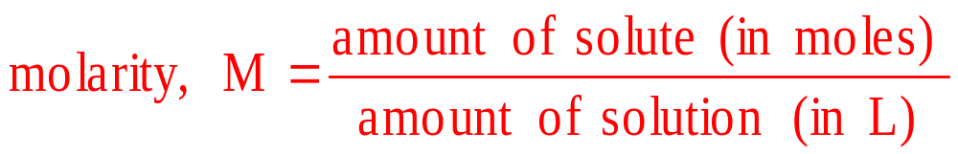
Solution Concentration
Molarity
moles of solute per 1 liter of solution
used because it describes how many molecules of solute in each liter of solution

Slide 13
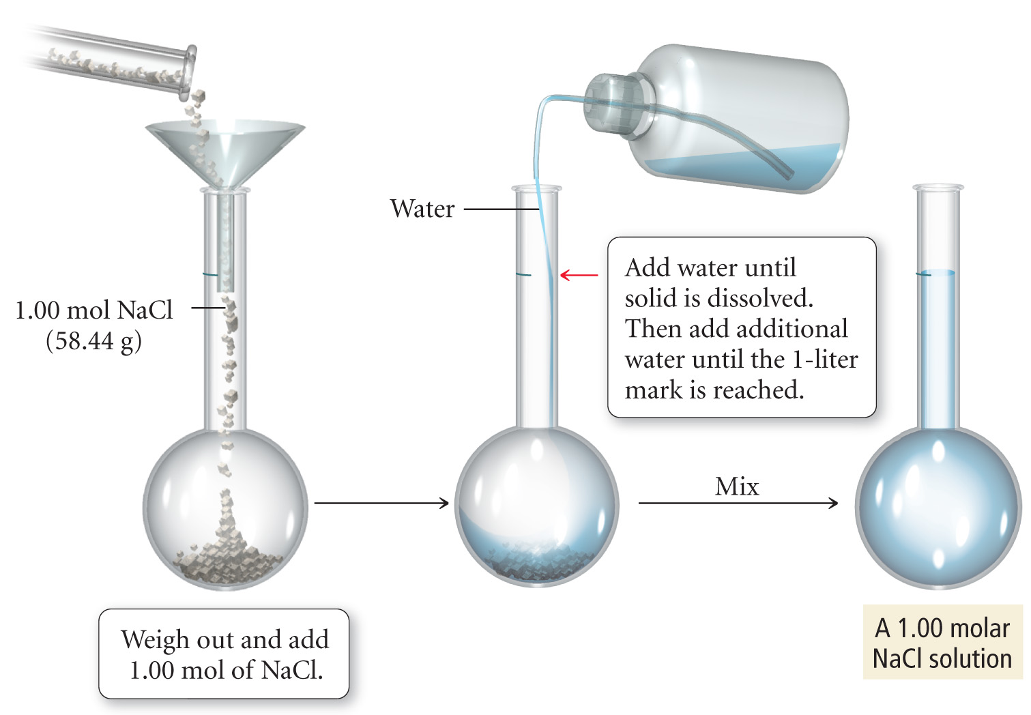
Preparing 1 L of a 1.00 M NaCl Solution
If I have 20ml of this solution, M is…

Slide 14
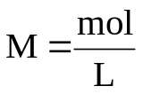
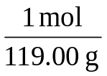
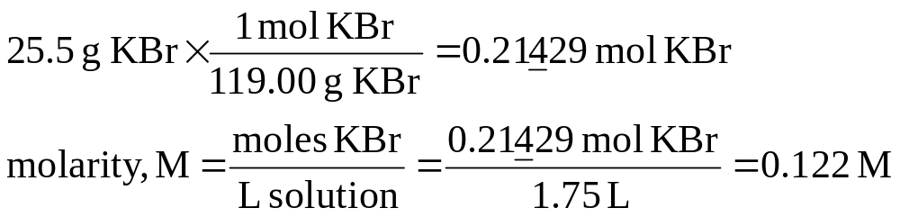
Example 4.5 – Find the molarity of a solution that has 25.5 g KBr dissolved in 1.75 L of solution
Sort Information
Given:
Find:
25.5 g KBr, 1.75 L solution
Molarity, M
Strategize
Concept Plan:
Relationships:
1 mol KBr = 119.00 g,
M = moles/L
g KBr
mol KBr
M
L sol’n
Follow the Concept Plan to Solve the problem
Solution:
Check
Check:
since most solutions are between 0 and 18 M, the answer makes sense

Slide 15
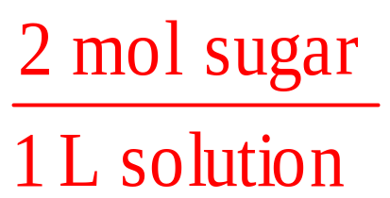
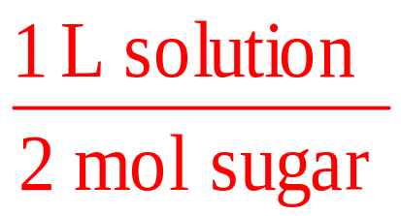
Using Molarity in Calculations
(Conversion)
molarity shows the relationship between the moles of solute and liters of solution
If a sugar solution concentration is 2.0 M, then 1 liter of solution contains 2.0 moles of sugar
  2 liters = 4.0 moles sugar
  0.5 liters = 1.0 mole sugar
1 L solution : 2 moles sugar

Slide 16
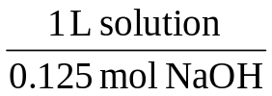
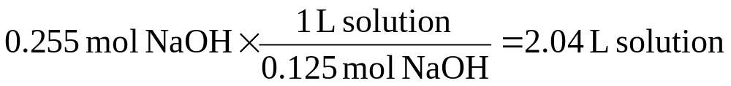
Example 4.6 – How many liters of 0.125 M NaOH contains 0.255 mol NaOH?
Sort Information
Given:
Find:
0.125 M NaOH, 0.255 mol NaOH
liters, L
Strategize
Concept Plan:
Relationships:
0.125 mol NaOH = 1 L solution
mol NaOH
L sol’n
Follow the Concept Plan to Solve the problem
Solution:
Check
Check:
since each L has only 0.125 mol NaOH, it makes sense that 0.255 mol should require a little more than 2 L

Slide 17
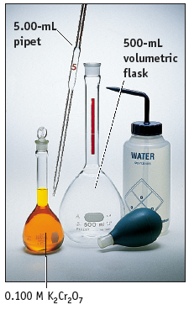
Preparing Solutions
Weigh out a solid solute and dissolve in a given quantity of solvent.
Dilute a concentrated solution to give one that is less concentrated.

Slide 18
PROBLEM: You have 50.0 mL of 3.0 M NaOH and you want 0.50 M NaOH. What do you do?
Add water to the 3.0 M solution to lower its concentration to 0.50 M
Dilute the solution!

Slide 19
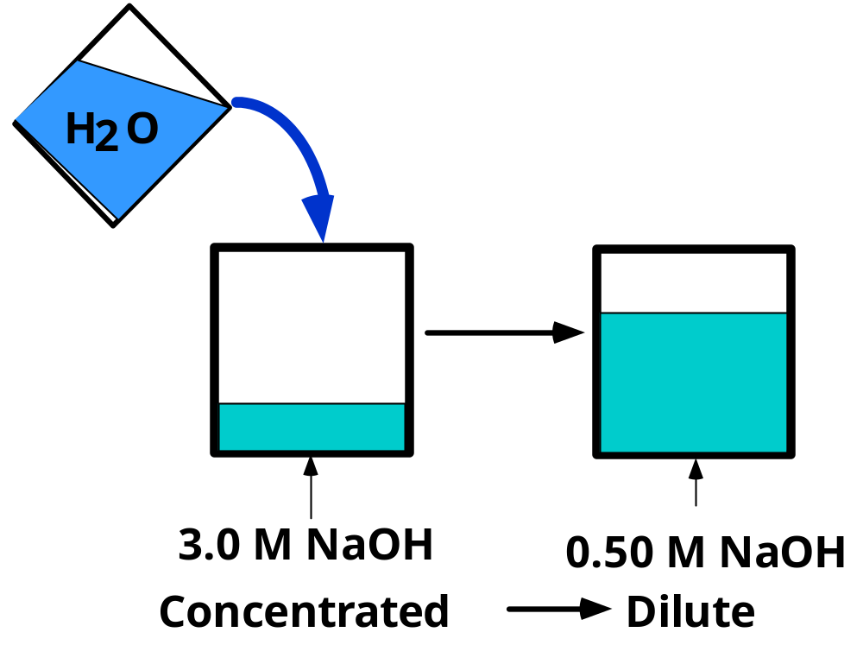
PROBLEM: You have 50.0 mL of 3.0 M NaOH and you want 0.50 M NaOH. What do you do?
But how much water
do we add?
(3.0 mol/L)(0.050 L) = 0.15 mol NaOH
??? mol NaOH

Slide 20
PROBLEM: You have 50.0 mL of 3.0 M NaOH and you want 0.50 M NaOH. What do you do?
How much water is added?
The important point is that --->
moles of NaOH in ORIGINAL solution =
moles of NaOH in FINAL solution

Slide 21
PROBLEM: You have 50.0 mL of 3.0 M NaOH and you want 0.50 M NaOH. What do you do?
Amount of NaOH in original solution =
M • V =
(3.0 mol/L)(0.050 L) = 0.15 mol NaOH
Amount of NaOH in final solution must also = 0.15 mol NaOH
Volume of final solution =
(0.15 mol NaOH)(1 L/0.50 mol) = 0.30 L or 300 mL

Slide 22
PROBLEM: You have 50.0 mL of 3.0 M NaOH and you want 0.50 M NaOH. What do you do?
Conclusion:
add 250 mL of water to 50.0 mL of 3.0 M NaOH to make 300 mL of 0.50 M NaOH.

Slide 23


Preparing Solutions by Dilution
A shortcut
M_{initial} • V_{initial} = M_{final} • V_{final}

Slide 24
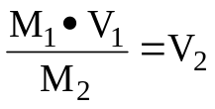
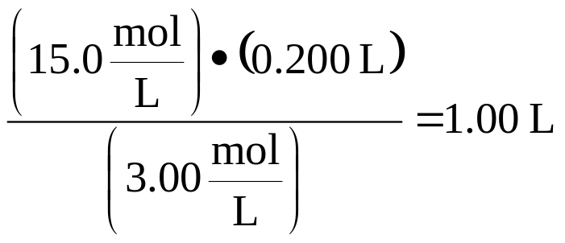
Example – To what volume should you dilute 0.200 L of 15.0 M NaOH to make 3.00 M NaOH?
Sort Information
Given:
Find:
V₁ = 0.200L, M₁ = 15.0 M, M₂ = 3.00 M
V₂, L
Strategize
Concept Plan:
Relationships:
M₁V₁ = M₂V₂
V₁, M₁, M₂
V₂
Follow the Concept Plan to Solve the problem
Solution:
Check
Check:
since the solution is diluted by a factor of 5, the volume should increase by a factor of 5, and it does

Slide 25
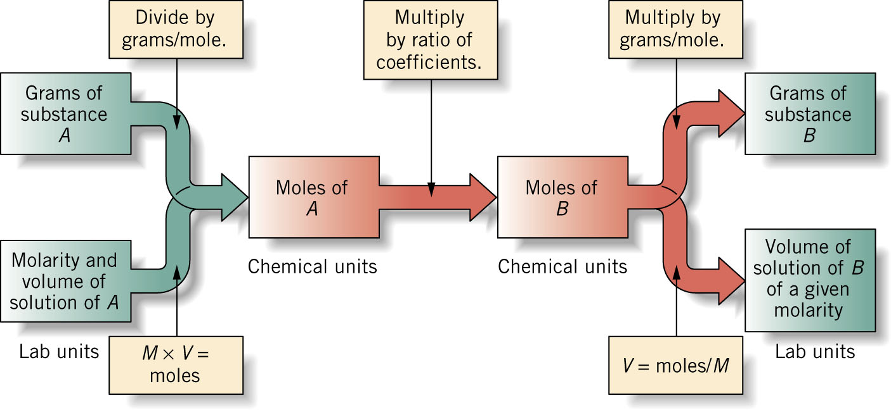
SOLUTION STOICHIOMETRY
Since molarity relates the moles of solute to the liters of solution, it can be used to convert between amount of reactants and/or products in a chemical reaction
Paths for working stoichiometry problems may be summarized with a flowchart:

Slide 26
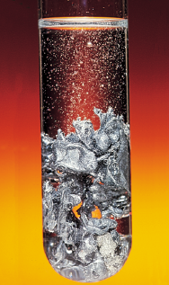
SOLUTION STOICHIOMETRY
Zinc reacts with acids to produce H₂ gas.
Have 10.0 g of Zn
What volume of 2.50 M HCl is needed to convert the Zn completely?
Zn(s) + 2 HCl(aq) --> ZnCl₂(aq) + H₂(g)
10.0g 2.50M
V = ?

Slide 27
GENERAL PLAN FOR STOICHIOMETRY CALCULATIONS
Mass
zinc
Mass
HCl
Stoichiometric
factor
Moles
zinc
Moles
HCl
Zn(s) + 2 HCl(aq) --> ZnCl₂(aq) + H₂(g)
10.0g 2.50M
V = ?
Volume
HCl

Slide 28
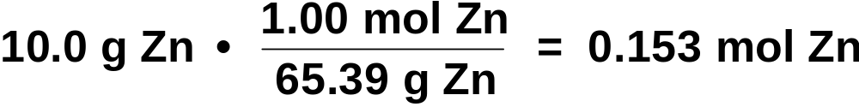
Zinc reacts with acids to produce H₂ gas. If you have 10.0 g of Zn, what volume of 2.50 M HCl is needed to convert the Zn completely?
Step 1: Write the balanced equation
Zn(s) + 2 HCl(aq) --> ZnCl₂(aq) + H₂(g)
Step 2: Calculate amount of Zn
Step 3: Use the stoichiometric factor
Zn(s) + 2 HCl(aq) --> ZnCl₂(aq) + H₂(g)
10.0g 2.50M
V = ?

Slide 29
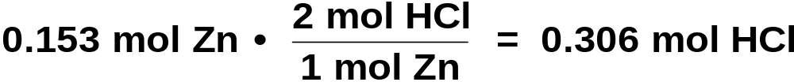
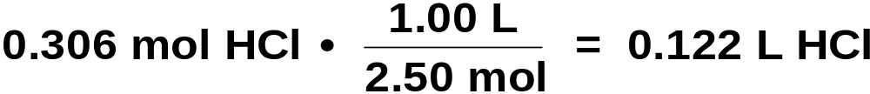
Zinc reacts with acids to produce H₂ gas. If you have 10.0 g of Zn, what volume of 2.50 M HCl is needed to convert the Zn completely?
Step 3: Use the stoichiometric factor
Step 4: Calculate volume of HCl req’d
Zn(s) + 2 HCl(aq) --> ZnCl₂(aq) + H₂(g)
10.0g 2.50M
V = ?

Slide 30
Let’s solve this problem:
  How many mL of 0.124 M NaOH are required to react completely with 15.4 mL of 0.108 M H₂SO₄?
  2 NaOH + H₂SO₄ → Na₂SO₄ + 2H₂O

Slide 31
  Example (Cont.): How many mL of 0.124 M NaOH are required to react completely with 15.4 mL of 0.108 M H₂SO₄?
  2 NaOH + H₂SO₄ → Na₂SO₄ + 2H₂O
  So what do we have?
  15.4mL of 0.108M H₂SO₄
Now it’s a stoichiometry question…

Slide 32
  Example (cont.): How many mL of 0.124 M NaOH are required to react completely with 15.4 mL of 0.108 M H₂SO₄?
  2 NaOH + H₂SO₄ → Na₂SO₄ + 2H₂O
  So what do we have?
  15.4mL of 0.108M H₂SO₄
Now what do we have?

Slide 33

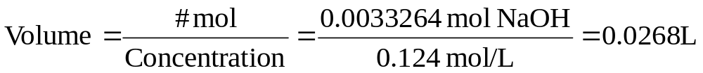
  (Cont.) Now we need 0.0033264 mol NaOH from a 0.124M solution
# of Moles
Concentration
Volume
In Summary…

Slide 34
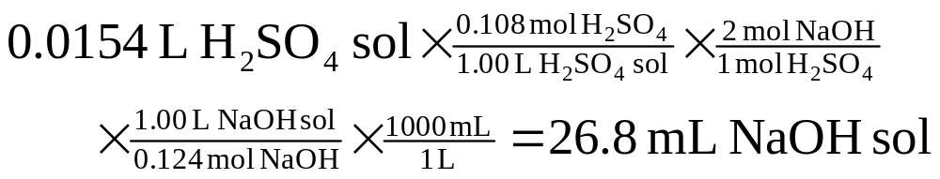
  Example (Cont.): How many mL of 0.124 M NaOH are required to react completely with 15.4 mL of 0.108 M H₂SO₄?
  2 NaOH + H₂SO₄ → Na₂SO₄ + 2H₂O
Another example …)

Slide 35
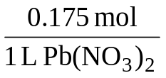
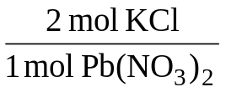
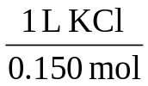
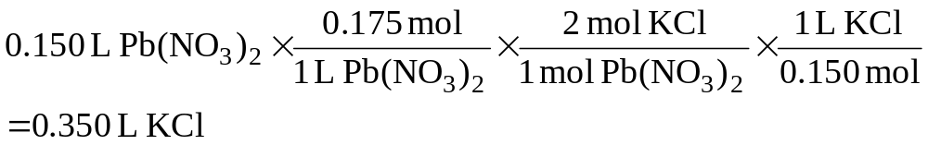
Example– What volume of 0.150 M KCl is required to completely react with 0.150 L of 0.175 M Pb(NO₃)₂ in the reaction
2 KCl(aq) + Pb(NO₃)₂(aq) → PbCl₂(s) + 2 KNO₃(aq)
Sort Information
Given:
Find:
0.150 M KCl, 0.150 L of 0.175 M Pb(NO₃)₂
L KCl
Strategize
Concept Plan:
Relationships:
1 L Pb(NO₃)₂ = 0.175 mol, 1 L KCl = 0.150 mol,
1 mol Pb(NO₃)₂ = 2 mol KCl
L Pb(NO₃)₂
mol Pb(NO₃)₂
mol KCl
L KCl
Follow the Concept Plan to Solve the problem
Solution:
Check
Check:
since need 2x moles of KCl as Pb(NO₃)_{2,} and the molarity of Pb(NO₃)₂ > KCl, the volume of KCl should be more than 2x volume Pb(NO₃)₂

Slide 36
Paths for working stoichiometry problems may be summarized with a flowchart:
Another example (Limit. Reagent problem…)

Slide 37
An example
56.50 mL of a 2.15 M ammonium sulfate solution is mixed with 36.0 g of iron (III) chloride.
If the reaction proceeds with a 65% yield, how much iron (III) sulfate would be acquired?

Slide 38
Limiting Reagent Problem!
What’s the first thing you need?
A balanced equation!
(NH₄)₂SO₄ + FeCl₃ → Fe₂(SO₄)₃ + NH₄Cl
How do you know this is the right products?
Charges! This is an example of a double replacement reaction. The cations get switched (or the anions, if you prefer).

Slide 39
Limiting Reagent Problem
We still need to balance it!
(NH₄)₂SO₄ + FeCl₃ → Fe₂(SO₄)₃ + NH₄Cl
3 (NH₄)₂SO₄ + 2 FeCl₃ → Fe₂(SO₄)₃ + 6 NH₄Cl

Slide 40
Armed with Stoichiometry!
56.50 mL of a 2.15 M ammonium sulfate solution is mixed with 36.0 g of iron (III) chloride.
If the reaction proceeds with a 65% yield, how much iron (III) sulfate would be acquired?
3 (NH₄)₂SO₄ + 2 FeCl₃ → Fe₂(SO₄)₃ + 6 NH₄Cl

Slide 41
Armed with Stoichiometry!
56.50 mL of a 2.15 M ammonium sulfate solution is mixed with 36.0 g of iron (III) chloride. If the reaction proceeds with a 65% yield, how much iron (III) sulfate would be acquired?
3 (NH₄)₂SO₄ + 2 FeCl₃ → Fe₂(SO₄)₃ + 6 NH₄Cl
36.0 g FeCl₃ *1 mol FeCl₃ * 1 mol Fe₂(SO₄)₃ * 399.87 g Fe₂(SO₄)₃= 44.37 g Fe₂(SO₄)₃
162.21 g FeCl₃ 2 mol FeCl₃ 1 mol Fe₂(SO₄)₃

Slide 42
Armed with Stoichiometry!
56.50 mL of a 2.15 M ammonium sulfate solution is mixed with 36.0 g of iron (III) chloride.
If the reaction proceeds with a 65% yield, how much iron (III) sulfate would be acquired?
3 (NH₄)₂SO₄ + 2 FeCl₃ → Fe₂(SO₄)₃ + 6 NH₄Cl
56.50 mL of 2.15 M (NH₄)₂SO₄ = ? mol (NH₄)₂SO₄
56.50 mL solut * 1 L solut * 2.15 mol (NH₄)₂SO₄ = 0.121 mol (NH₄)₂SO₄
1000 mL solut 1 L solution
0.121 mol (NH₄)₂SO₄ * 1 mol Fe₂(SO₄)₃ * 399.87 g Fe₂(SO₄)₃ = 16.13 g Fe₂(SO₄)₃
3 mol (NH₄)₂SO₄ 1 mol Fe₂(SO₄)₃

Slide 43
Armed with Stoichiometry!
56.50 mL of a 2.15 M ammonium sulfate solution is mixed with 36.0 g of iron (III) chloride. If the reaction proceeds with a 65% yield, how much iron (III) sulfate would be acquired?
3 (NH₄)₂SO₄ + 2 FeCl₃ → Fe₂(SO₄)₃ + 6 NH₄Cl
Limiting Reagent is (NH₄)₂SO_{4:} 16.13 g Fe₂(SO₄)₃ theoretical
65 % actual x16.13 g Fe₂(SO₄)₃ theoretical * = 10.48 g actual Fe₂(SO₄)₃
100 % theoretical

